Slide 1
Women in Science and Medicine:
Mentoring and Retention Along the Academic Pipeline
Megan Castle

Slide 2
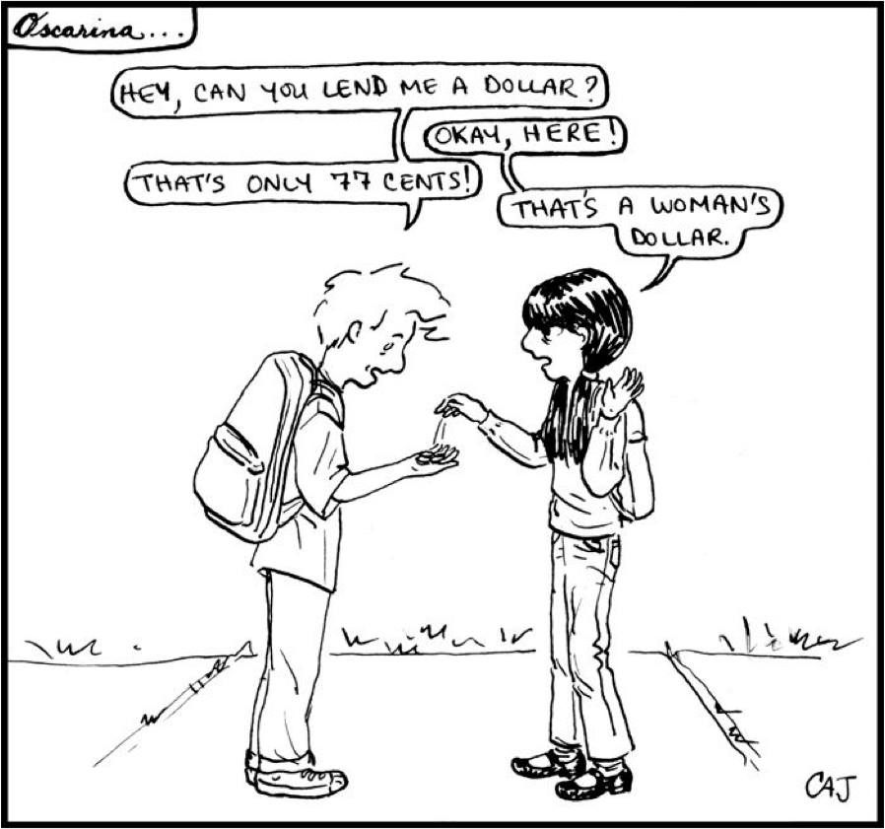
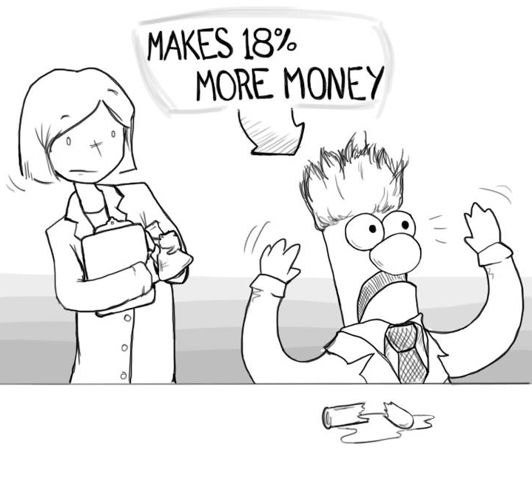
Gender Equity in Academic Career Advancement
Sources: http://oscarinaland.com
http://www.nature.com/news/inequality-quantified-mind-the-gender-gap-1.12550#/pay

Slide 3
Key Findings from Literature Review
Women in Science: Historical Context
Nationally, women hold only 7-16% of tenured physical science professorships
Women Electing to Study Science
National % of female physical science baccalaureate majors has been decreasing since 2002
Female Attrition in Science Academia
Greater familial responsibilities, wage gaps, lower publication rates, & lack of mentoring lead to female attrition
Impact of Mentoring on Female Retention
Mentoring leads to career development, satisfaction, & research advances

Slide 4
How do two hybridized mentoring programs help participants, female students and faculty in science and medicine at a Research I Institution, overcome factors that lead to attrition in those fields?

Slide 5
How do two hybridized mentoring programs help participants, female students and faculty in science and medicine at a Research I Institution, overcome factors that lead to attrition in those fields?

Slide 6
How do two hybridized mentoring programs help participants, female students and faculty in science and medicine at a Research I Institution, overcome factors that lead to attrition in those fields?

Slide 7
W.I.S.E. Hybridized Mentoring Programs
Women’s Health Science Mentoring Program
8 Female high school students & 8 medical/graduate students
Group and dyadic mentorship
Women in Science Journal Club
4 Postdoctoral & pre-tenure faculty & 4 tenured science/medical faculty
Group and dyadic mentorship
Conduct self-selected research projects & bi-monthly meetings
Review and discuss current literature & meet in weekly cohorts

Slide 8
Data Collection Methods
WISE Pre-Program Surveys
WISE Post-Program Surveys
Pre-Existing Data
WISE Interviews
N= 694
N= 24
N= 8

Slide 9
Northwestern University Graduate Students by Discipline and Gender

Slide 10
Pre-Program Perceptions and Experiences of Gender Inequity

Slide 11
Pre-Program Perceptions and Experiences of Gender Inequity
“The gender climate isn’t talked about enough. Academics in science refuse to admit gender bias exists because that implies that they, as some of the most educated people in the world, still have implicit and explicit bias.” –Second Year Medical Student
“I think in the past I haven’t received the type of mentorship or the type of role models that I have needed because of the gender climate.” -Tenured Professor

Slide 12
Themes Coded in Pre-Program Surveys by Population

Slide 13
Themes Coded in Post-Program Surveys and Interviews by Population

Slide 14
Post-Program Attitudes and Experiences
“Academia is a daunting place, so I am grateful the mentors allowed us to ease our ways into this new dimension. My mentor also served as a role model for me.” –H.S. Junior
“[This program] inspires me even more to break these barriers that stand in my way and achieve what other women are not able to achieve or have backed away from. It’s empowering.” –M2
“I think this group gave me courage to continue pursuing my career. I am married and have children, and this group made me think that I should keep moving forward in this career, despite what others think.” –Postdoctoral Fellow
“I think a lot about other careers and changing, so having this [program] makes me think maybe it’s important to give it another shot to get to the next stage and prove that it can be done.”
–Research Assistant Professor
“I feel like I’m at a point in my career where it is what it is and now I’m turning to thinking ‘How can I help other people? And how can I help even just one person not drop out because of the gender imbalance and the gender differences of experiences, the bias?’…I’m always on the lookout for new mentees.” –Tenured Professor

Slide 15
Post-Program Attitudes and Experiences
“Academia is a daunting place, so I am grateful the mentors allowed us to ease our ways into this new dimension. My mentor also served as a role model for me.” –H.S. Junior
“[This program] inspires me even more to break these barriers that stand in my way and achieve what other women are not able to achieve or have backed away from. It’s empowering.” –M2
“I think this group gave me courage to continue pursuing my career. I am married and have children, and this group made me think that I should keep moving forward in this career, despite what others think.” –Postdoctoral Fellow
“I think a lot about other careers and changing, so having this [program] makes me think maybe it’s important to give it another shot to get to the next stage and prove that it can be done.”
–Research Assistant Professor
“I feel like I’m at a point in my career where it is what it is and now I’m turning to thinking ‘How can I help other people? And how can I help even just one person not drop out because of the gender imbalance and the gender differences of experiences, the bias?’…I’m always on the lookout for new mentees.” –Tenured Professor

Slide 16
Post-Program Attitudes and Experiences
“Academia is a daunting place, so I am grateful the mentors allowed us to ease our ways into this new dimension. My mentor also served as a role model for me.” –H.S. Junior
“[This program] inspires me even more to break these barriers that stand in my way and achieve what other women are not able to achieve or have backed away from. It’s empowering.” –M2
“I think this group gave me courage to continue pursuing my career. I am married and have children, and this group made me think that I should keep moving forward in this career, despite what others think.” –Postdoctoral Fellow
“I think a lot about other careers and changing, so having this [program] makes me think maybe it’s important to give it another shot to get to the next stage and prove that it can be done.”
–Research Assistant Professor
“I feel like I’m at a point in my career where it is what it is and now I’m turning to thinking ‘How can I help other people? And how can I help even just one person not drop out because of the gender imbalance and the gender differences of experiences, the bias?’…I’m always on the lookout for new mentees.” –Tenured Professor

Slide 17
Post-Program Attitudes and Experiences
“Academia is a daunting place, so I am grateful the mentors allowed us to ease our ways into this new dimension. My mentor also served as a role model for me.” –H.S. Junior
“[This program] inspires me even more to break these barriers that stand in my way and achieve what other women are not able to achieve or have backed away from. It’s empowering.” –M2
“I think this group gave me courage to continue pursuing my career. I am married and have children, and this group made me think that I should keep moving forward in this career, despite what others think.” –Postdoctoral Fellow
“I think a lot about other careers and changing, so having this [program] makes me think maybe it’s important to give it another shot to get to the next stage and prove that it can be done.”
–Research Assistant Professor
“I feel like I’m at a point in my career where it is what it is and now I’m turning to thinking ‘How can I help other people? And how can I help even just one person not drop out because of the gender imbalance and the gender differences of experiences, the bias?’…I’m always on the lookout for new mentees.” –Tenured Professor

Slide 18
Post-Program Attitudes and Experiences
“Academia is a daunting place, so I am grateful the mentors allowed us to ease our ways into this new dimension. My mentor also served as a role model for me.” –H.S. Junior
“[This program] inspires me even more to break these barriers that stand in my way and achieve what other women are not able to achieve or have backed away from. It’s empowering.” –M2
“I think this group gave me courage to continue pursuing my career. I am married and have children, and this group made me think that I should keep moving forward in this career, despite what others think.” –Postdoctoral Fellow
“I think a lot about other careers and changing, so having this [program] makes me think maybe it’s important to give it another shot to get to the next stage and prove that it can be done.”
–Research Assistant Professor
“I feel like I’m at a point in my career where it is what it is and now I’m turning to thinking ‘How can I help other people? And how can I help even just one person not drop out because of the gender imbalance and the gender differences of experiences, the bias?’…I’m always on the lookout for new mentees.” –Tenured Professor

Slide 19
Post-Program Attitudes and Experiences
“Academia is a daunting place, so I am grateful the mentors allowed us to ease our ways into this new dimension. My mentor also served as a role model for me.” –H.S. Junior
“[This program] inspires me even more to break these barriers that stand in my way and achieve what other women are not able to achieve or have backed away from. It’s empowering.” –M2
“I think this group gave me courage to continue pursuing my career. I am married and have children, and this group made me think that I should keep moving forward in this career, despite what others think.” –Postdoctoral Fellow
“I think a lot about other careers and changing, so having this [program] makes me think maybe it’s important to give it another shot to get to the next stage and prove that it can be done.”
–Research Assistant Professor
“I feel like I’m at a point in my career where it is what it is and now I’m turning to thinking ‘How can I help other people? And how can I help even just one person not drop out because of the gender imbalance and the gender differences of experiences, the bias?’…I’m always on the lookout for new mentees.” –Tenured Professor

Slide 20
Study Limitations and Conclusions
Limitations include: 1) researcher bias; 2) institutional scope; 3) sample population and size; and 4) study length
A hybridized mentoring approach facilitated opportunities for cross-departmental interactions and research opportunities among students and professionals of all ages and expertise
These multi-disciplinary relationships cultivated a community of women linked through shared experiences
Participants noted feeling a sense of empowerment and reinvigoration to continue persisting on their career paths despite perceived gender barriers

Slide 21
Implications for Higher Education Administrators
Utilizing hybridized mentoring interventions may improve cross-departmental interactions among students and professionals in higher education, cultivating a stronger sense of community among women in departments where gender parity is not yet achieved
Higher education administrators might consider:
Assessing the gender climate of women in academia
Evaluating institutional policies that may have gendered implications
Developing improved and targeted dyadic and group mentoring interventions for populations at risk of attrition
Further research is needed to analyze any longitudinal impacts of these hybridized mentoring programs

Slide 22




Questions?
Professional Advancement
Community Networks
Research Collaborations
Mentoring
Scholars

